Slide 1

Intro to Git
Otniel Yosi Viktorisa
Product Developer Team Lead at PT. Altrovis Tekno Global
otniel.y.viktorisa@gmail.com

Slide 2
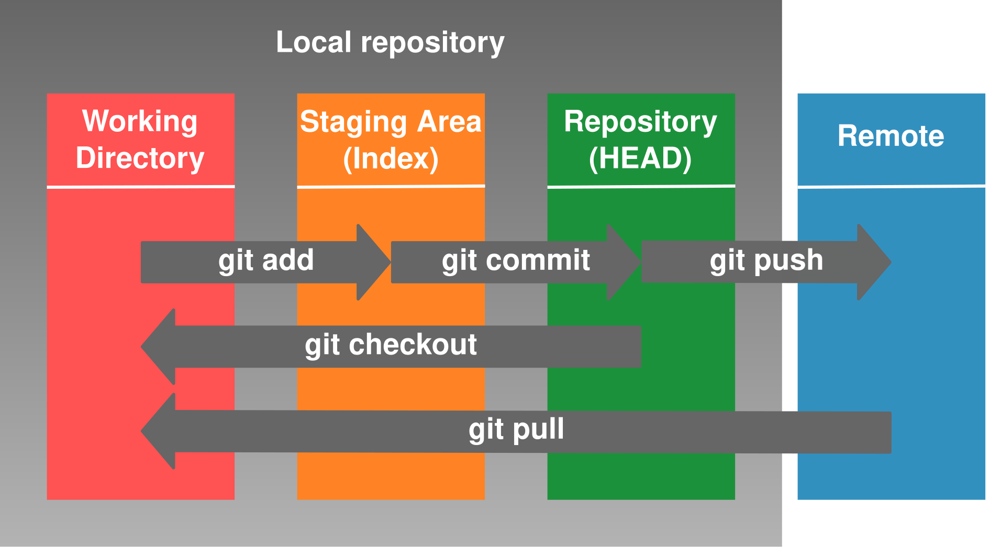
What is Git?
free and open source distributed version control system
Image:https://neurathsboat.blog/post/git-intro/

Slide 3
Starting command
git config --global user.name “<username>”
git config --global user.email “<email>”
git init
git branch -M <branch_name>
git remote add origin <server>
git clone <server>

Slide 4
Working command
git checkout –b <new_branch> <branch_name | tag>
git checkout <branch_name>
git status
git add <file_name | . >
git commit –m “<message>”
git push origin <branch_name>
git pull

